Slide 1

Parkside, Tulsa, OK November 2019
John F. Kelly, PhD, ABPP
Recovery from SUD
Notes:
Title: Recovery From Alcohol and Drugs Problems in a National Sample of U.S. Adults: Prevalence, Pathways, and Predictors
Talk Description: While much is known about the causes, clinical course, and treatment, of addiction, little is known about the prevalence, processes, pathways, and predictors of long-term remission and recovery.
This presentation reviews and discusses findings from the first nationally-representative study of U.S. adults who have resolved a significant alcohol or other drug problem, examines their varied pathways
to problem resolution, and describes the predictors of use of those pathways. Findings regarding changes in quality of life with time in recovery and smoking status and cessation will also be reviewed.
Learning Objectives
By the end of this presentation participants will be able to:
1. Describe recovery prevalence in the United States
2. Name the major pathways that people use to recover
3. Specify the changes in quality of life that occur with time in recovery

Slide 2

Addiction
Etiology
Epidemiology
Typology
Phenomenology
Prevention
Treatment
Recovery

Slide 3
ADDICTION IS A COMPLEX DISORDER
RISK AND PROTECTIVE FACTORS
Biology/Genes
Environment
Genetics
Gender
Mental Health
Chaotic home and abuse
Parent’s use and attitudes
Peer influence
Community attitudes
Poor school achievement
Route of administration
Effect of drug itself
Drug
Early use
Availability
Cost
Brain Mechanisms
Addiction
Notes:
Most conditions and diseases have a genetic component. Some disorders, such as sickle cell disease and cystic fibrosis, are caused by mutations in a single gene. SUD and addiction, and mental health conditions, in contrast, are “complex” disorders caused by interactions among genes/biology, environment, and lifestyle….

Slide 4
RECOVERY IS A COMPLEX PROCESS
RISK AND PROTECTIVE FACTORS
Biology/Genes
Environment
Genetics
Gender
Mental Health
Safe and stable housing
Family/peer attitudes
Peer influence
Community attitudes
Recovery capital (employment/training/education…)
Medications
Psychosocial Treatments
Rx + Rss
Early intervention
Availability
Cost
Brain Mechanisms
Recovery
Notes:
Most conditions and diseases have a genetic component. Some disorders, such as sickle cell disease and cystic fibrosis, are caused by mutations in a single gene. SUD and addiction, and mental health conditions, in contrast, are “complex” disorders caused by interactions among genes/biology, environment, and lifestyle….

Slide 5
The clinical course of addiction and achievement of stable recovery can take a long time …
Addiction Onset
Help Seeking
Full Sustained Remission (1 year abstinent)
Relapse Risk drops below 15%
4-5 years
8 years
5 years
Opportunity for earlier detection through screening in non-specialty settings like primary care/ED
Self-initiated cessation attempts
4-5 Treatment episodes/
mutual-help
Continuing care/
mutual-help
50-60% of individuals with addiction will achieve full sustained remission
Recovery Priming
Recovery Mentoring
Recovery Monitoring
Notes:
Wang, P. S., Berglund, P., Olfson, M., Pincus, H. A., Wells, K. B., & Kessler, R. C. (2005). Failure and delay in initial treatment contact after first onset of mental disorders in the National Comorbidity Survey Replication. Arch Gen Psychiatry, 62(6), 603-613. doi: 62/6/603 [pii]
10.1001/archpsyc.62.6.603
Dennis, M. L., Scott, C. K., Funk, R., & Foss, M. A. (2005). The duration and correlates of addiction and treatment careers. J Subst Abuse Treat, 28 Suppl 1, S51-62. doi: S0740-5472(04)00138-2 [pii] 10.1016/j.jsat.2004.10.013
De Soto, C.B., O’Donnell, W.E., & De Soto, J.L. (1989). Long-term recovery in alcoholics. Alcoholism: Clinical
and Experimental Research, 13, 693-697. Vaillant, G. E. (1996). A long-term follow-up of male alcohol abuse.
Archives of General Psychiatry, 53(3), 243-249. Nathan, P., & Skinstad, A. (1987). Outcomes of treatment for
alcohol problems: Current methods, problems and results. Journal of Consulting and Clinical Psychology, 55,
332-340. Dawson, D. A. (1996). Correlates of past-year status among treated and untreated persons with
former alcohol dependence: United States, 1992. Alcoholism: Clinical and Experimental Research, 20(4),
771-779. Jin, H., Rourke, S. B., Patterson, T. L., Taylor, M. J., & Grant, I. (1998). Predictors of relapse in
long-term abstinent alcoholics. Journal of Studies on Alcohol, 59, 640-646. Dennis, M. L., Foss, M. A., &
Scott, C. K. (2007). An eight-year perspective on the relationship between the duration of abstinence and other
aspects of recovery. Evaluation Review, 31(6), 585-612. Schutte, K., Byrne, F., Brennan, P., & Moos, R.
(2001). Successful remission of late-life drinking problems: A 10-year follow-up. Journal of Studies on
Alcohol 62, 322-334.

Slide 6
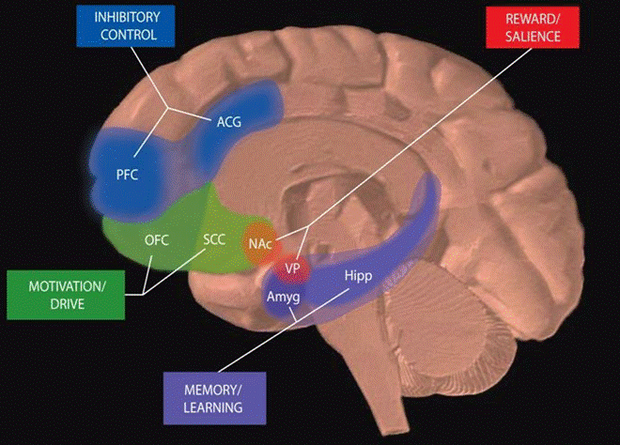
Circuits Involved in Drug Use and Addiction
Key:
PFC: prefrontal cortex
ACG: anterior cingulate gyrus
OFC: orbitofrontal cortex
SCC: subcallosal cortex
NAc: nucleus accumbens
VP: ventral pallidum
Hipp: hippocampus
Amyg: amygdala
All of these brain regions must be considered in developing strategies to effectively treat addiction.
Notes:
We have known for a long time that there are functional and structural changes in the brain due to chronic exposure to substances like alcohol and other drugs; and it takes time for the brain to recalibrate and readjust for people entering recovery. People remain vulnerable to stressors and have a prolonged inability to experience normal levels of reward…
When people abstain – make it stressful to remain abstinent
Addiction is a disorder with complex interactions between biological and social variables.
One of the reasons why these recovery support services have grown is because we know that substance use has profound effects on the brain, which can be very stressful.
These areas contain multiple brain circuits involved in drug use and addiction, which underlie feelings of reward (NAc and VP), learning and memory (amygdala and hippocampus), motivation and drive (OFC and SCC), and inhibitory control (PFC and ACG). These circuits work together and change with experience. During addiction, the enhanced value of the substance in the reward, motivation, and memory circuits overcomes the inhibitory control exerted by the PFC, favoring a positive feedback loop initiated by consumption of the drug and perpetuated by enhanced activation of motivation/drive and memory circuits.
Treatments can be “bottom up” (limbic system; e.g., medications) or, “top down” psychosocial treatments (e.g., CBT, 12-step)

Slide 7
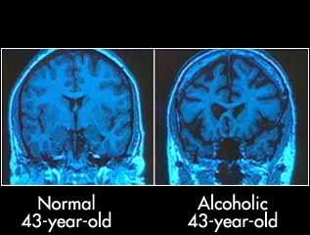
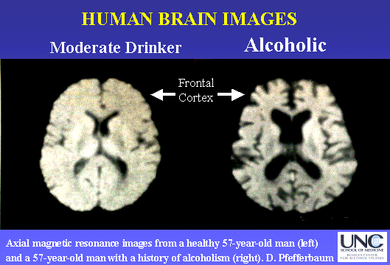
Notes:
Structurally, we see dramatic changes in the brain. On the right we see here the brain of an alcohol addicted person; on the left, a moderate drinker. Now, as a trained scientist I know that the hole on the right is bigger than the hole on the left. Also, what we scientists call “the brain’s wobbly bits” are also substantially smaller. THe point here is, that you don’t have to look very long or hard to see how radically the brain is affected; this helps us understand what we observe when an organism with the propesnsity for approximately 80yrs or so of life, self-desctructs, malfunctions, poisoning itself to death prematurely by approx. 30yrs on avg… So, people remain vulnerable to stressors for quite a while post-abstinence … in fact we know that stress is one of the main precursors to relapse early following cessation…

Slide 8
Physiological Theories
General Adaptation Syndrome
(Selye, 1956)
Alarm---- Resistance---Exhaustion
Notes:
The notion of stress, exhaustion, illness, and death has been studied since Selye in the ‘50s …. Organisms attempting to resist become exhausted without inputs…. RSS can provide inputs…. Ideally in the communities in which people operate…

Slide 9
Post-acute withdrawal effects:
More stress and lowered ability to experience normal pleasures
Increased sensitivity to stress via…
Increased activity in hypothalamic-pituitary-adrenal axis (HPA-axis) and CRF/Cortisol release
Lowered ability to experience normal levels of reward via…
Down-regulated dopamine D2 receptor volume increasing risk of protracted dysphoria/anhedonia and relapse risk
Notes:
These changes in the brain can lead to increased hypersensitivity to stress early in recovery. We sometimes call these protracted or post-acute withdrawal effects, during which time there is a lowered ability to experience normal pleasures and increased activity in certain stress hormones. This makes it very difficult to adjust to abstinence and remission and cope with the demands of recovery early on.
People are at heightened sensitivity to stress early in recovery, in the first year or two.
Substance use has effects at multiple biological and environmental (social) levels
Characterized by physiological changes in the central nervous system, as well as psychological and social ones

Slide 10
Neuroscience of Recovery Capital
If addiction is a disease of the brain could jobs, recovery housing, and friends, change the brain, upregulate down-regulated receptor systems, and increase the chances of long-term remission?

Slide 12
Social Buffering
Stress-buffering effects of social relationships- one of the major findings of past century
Mechanisms of this poorly understood

Slide 13
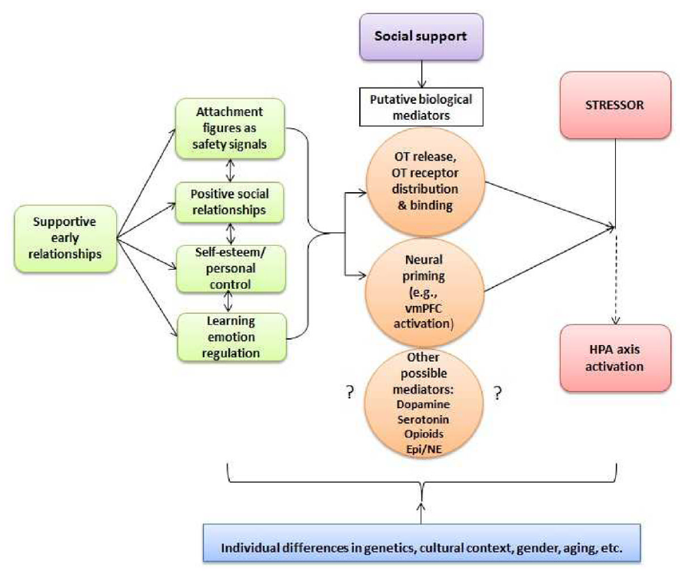
RESPONDING TO STRESS: SOCIAL BUFFERING
…and researchers have started to examine possible neurobiological connections between social support and individual stress responses
Figure 1. A Developmental Working Model of Social Buffering of the HPA Axis in Humans
OT = oxytocin, vmPFC = ventro-medial prefrontal cortex, Epi = epinephrine, NE = norepinephrine
Hostinar, C. E., Sullivan, R. M., & Gunnar, M. R. (2014). Psychobiological Mechanisms Underlying the Social Buffering of the HPA Axis: A Review of Animal Models and Human Studies across Development. Psychological Bulletin, 140(1).
Notes:
JK NOTES:
Psychological epigenetic dynamic systems perspective
(Gilbert Gottlieb)
Social Information- Processing Model
(Ken Dodge)
Encoding
Mental representation
Response Accessing
Evaluation
Enactment

Slide 14
RESPONDING TO STRESS: SOCIAL BUFFERING
…and researchers have started to examine possible neurobiological connections between social support and individual stress responses
Figure 1. A Developmental Working Model of Social Buffering of the HPA Axis in Humans
OT = oxytocin, vmPFC = ventro-medial prefrontal cortex, Epi = epinephrine, NE = norepinephrine
Hostinar, C. E., Sullivan, R. M., & Gunnar, M. R. (2014). Psychobiological Mechanisms Underlying the Social Buffering of the HPA Axis: A Review of Animal Models and Human Studies across Development. Psychological Bulletin, 140(1).
Notes:
JK NOTES:
Psychological epigenetic dynamic systems perspective
(Gilbert Gottlieb)
Social Information- Processing Model
(Ken Dodge)
Encoding
Mental representation
Response Accessing
Evaluation
Enactment

Slide 15
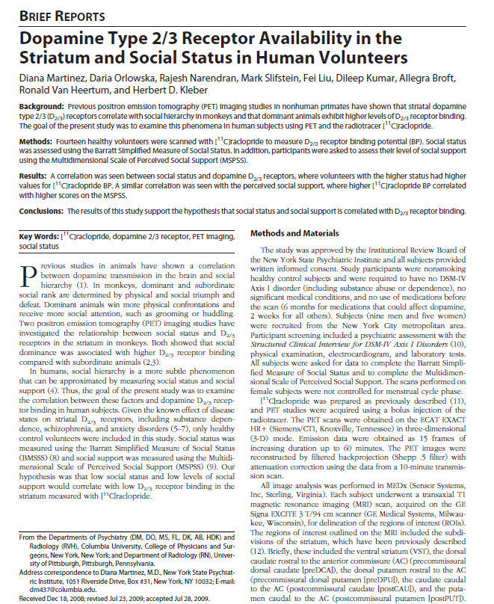
D2/D3 RECEPTOR BINDING & SOCIAL STATUS AND SUPPORT
AIM
Assess whether D_{2/3} receptor levels correlate with social status and social support (particularly, to determine if low social status and low social support correlate with low D_{2/3} receptor binding)
SAMPLE
N = 14 healthy participants (i.e., non-smoking with no Axis I disorders, significant medical conditions, or use of medications before the scan) who were scanned using positron emission tomography (PET) imaging to measure D_{2/3} receptor binding potential (BP)
MEASURES
Barratt Simplified Measure of Social Status (BMSSS) to measure social status
Scale of Perceived Social Support (MSPSS) to measure social support
[¹¹C]raclopride to measure D_{2/3} receptor binding in the striatum
OUTCOMES
Positive correlation between D_{2/3} receptor binding potential and social status
Positive correlation between D_{2/3} receptor binding potential and perceived social support
Results similar to prior studies of nonhuman primates, which show higher D_{2/3} receptor levels in monkeys who are dominant in their social hierarchy, compared to those who are subordinate
Martinez, D., Orlowska, D., Narendran, R., Slifstein, M., Liu, F., Kumar, D., . . . Kleber, H. D. (2010). Dopamine type 2/3 receptor availability in the striatum and social status in human volunteers. Biological Psychiatry, 67(3), 275-278. doi:10.1016/j.biopsych.2009.07.037

Slide 16
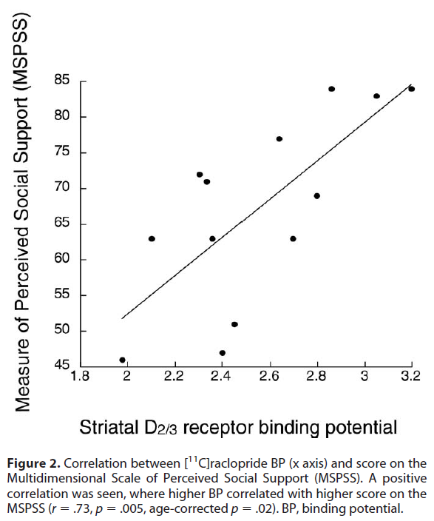
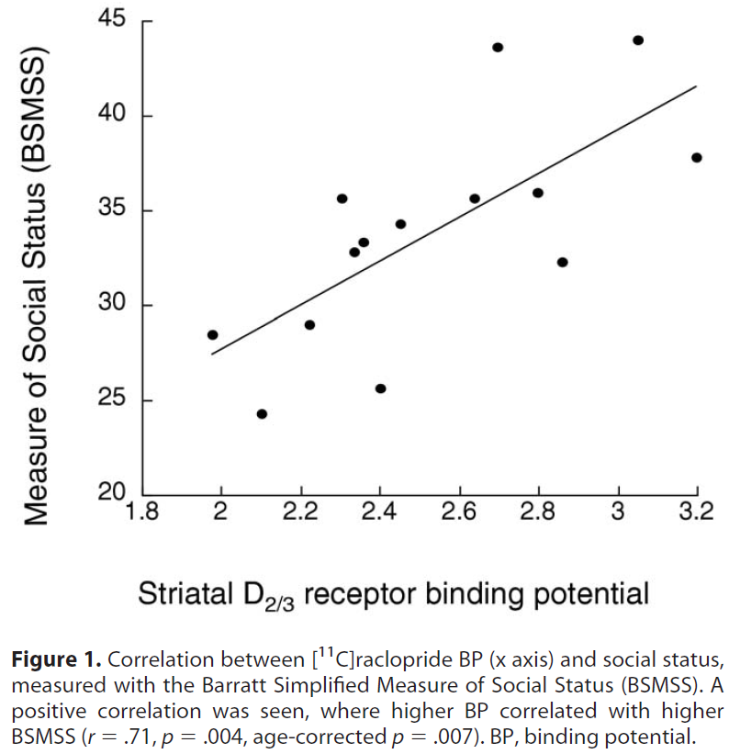
D2/D3 RECEPTOR BINDING & SOCIAL STATUS AND SUPPORT
D_{2/3} receptor binding increases as social status increases.
D_{2/3} receptor binding increases as social support increases.
Martinez, D., Orlowska, D., Narendran, R., Slifstein, M., Liu, F., Kumar, D., . . . Kleber, H. D. (2010). Dopamine type 2/3 receptor availability in the striatum and social status in human volunteers. Biological Psychiatry, 67(3), 275-278. doi:10.1016/j.biopsych.2009.07.037
Notes:
But here, in this study, we don’t know the direction of causation. Does greater D2/D3 receptor availability lead to increases in social support/social status; or, does greater social status/social support lead to greater D2/D3 availability? We also know that higher density/availability of D2/D3 receptor is associated with lower risk of alcohol/drug use and these receptors are down-regulated by chronic drug administration/exposure. This is difficult to manipulate experimentally in humans, but it is easier to manipulate in animals/primates…

Slide 17
Monkeys, like humans, love to be with each
Other, and also like cocaine…
Notes:
All monkeys were individually housed for 1.5yrs and scanned. Then, monkeys were introduced into housing groups with 4 in each house. Within 3 months, after a social hierarchy had been established, the dominant monkeys showed 22% increase in DVR compared to no change in the subordinate monkeys which subsequently protected them against high cocaine use….

Slide 18
The importance of social context, control over environment, and relapse risk
When all monkeys were individually housed no difference in DA D2 receptor volume
After 3 months of social housing, dominant monkeys showed 22% increase in DA D2 volume; subordinate monkeys - no change
Increase in DA D2 associated with lower likelihood of cocaine use
“Dominance” defined as: easy access to food and water, social mobility, and greater environmental control.
Human Implications: facilitating greater access to and availability of recovery capital may instill hope, empower people, help them have more control over their environment, increase social contact and social mobility through the environment, and thereby induce neurochemical changes that reduces relapse risk
Notes:
So, providing recovery capital may actually change the brain and help sustain recovery…. BUT…
Also, study by Volkow et al 1999 (N. D. et al. Prediction of reinforcing responses to psychostimulants
in humans by brain dopamine D2 receptor levels. Am. J. Psychiatry 156,
1440–1443 (1999).) found that humans with low D2 volume had more positive response to methylphenidate than humans with high D2 volume…..suggesting a protective effect of high D2 volume; AND this study suggests the environment can change this.

Slide 19
Cue Induced
Stress Induced
RELAPSE
Social
Substance Induced
Psych
BioNeuro
Recovery Support Services
Kelly, JF Yeterian, JD In: McCrady and Epstein Addictions: A comprehensive Guidebook, Oxford University Press (2013)
Notes:
In fact, we know that stress is one of the major precursors of relapse, along with cues, such as people, places, things, and moods, and priming doses of the substance, like one or two drinks, for example. So, how might RSSs reduce relapse risk and aid recovery? One of the ways that recovery community centers could help mitigate this relapse risk is by mobilizing changes to biopsychosocial factors.
The most common triggers for relapse.
Just as addiction affects physical, emotional, social and spiritual aspects of an individual's life, the road to relapse may have signs that appear in all areas of one’s life.
Recovery is a biopsychosocial healing process and a commitment to change and growth.

Slide 20
Treatment and Recovery Support Services ideally should be…
Available
Accessible
Affordable
Attractive
Evidence-based
Diverse

Slide 21
Cadre of Emerging and Growing Long-term Recovery Support Services Now Exist…
Recovery
Mutual help organizations
Peer-based recovery support services
Sober living environments
Clinical models of long-term recovery management
Recovery community centers
Recovery supports in educational settings
(sober dorms)
Notes:
Mutual aid (e.g., AA) began in 1930s out of a grass roots need to find something not provided by the medical community (relapse prevention/recovery management). Research finding that peer support provided in AA and “warm handoffs” (e.g., Sisson and Mallams, 1981) could substantially increase the odds linkage to AA from treatment, PBRSS emerged to formalize the structure of peer support in clinical and rSS settings (e.g., RCCs). The notion that environment and peer support was conducive to ongoing recovery and increasing array of sober living environments emerged (including Oxford Houses in 1975). The need to increase recovery capital lead to the additional formation of RCCs as a means to provide daytime support as well as instrumental support to aid in job preparation and finding and linkages to other social support services; The need to increase recovery supports for young people led to the formation of RHSs and CRPs. Finally, long-term clinical support has emerged in the 1970s as both recovery residences (Halfway Houses in particular) and then extended care via face to face or telephone counseling and now models of RMCs (e.g., Scott and Dennis).
Given the origin of many of these RSSs emerged from grassroots initiatives and NOT from clinical science or settings, some perceive a tension or even divide in some quarters between formal clinical approaches and RSSs. A move by SAMHSA to codify and create ROSC is an attempt to increase between all levels of these services including more formal clinical services …. The point is to build bridges among all of these so it creates a cost-effective network of support to aid recovery.

Slide 22
RSS Goal
Remission + Enhanced QOL
RSS

Slide 23
RSS Mechanisms
Bio
Psycho
Social
Spiritual
Change
Remission + Enhanced QOL
RSS
Recovery
Capital
Notes:
Principles of RSS are likely similar; specific practices may differ …. The extent of
relative benefits from different practices is largely unknown.

Slide 24
Overarching Principles possibly at play within and across RSSs
Universality
Instillation of Hope
Catharsis
Cohesion
Imparting of Information
Altruism
Imitative Behavior
Socialization Techniques
Existential Factors
Interpersonal Learning
Self-Understanding/insight
Source: Yalom, 1995

Slide 25

Recovery research
National Recovery Study
What is the prevalence of alcohol or other drug problem resolution?
What proportion self-identify as being “in recovery”?
What are the pathways followed?
How many serious attempts does it take to resolve AOD problems?
What is quality of life and functioning like in recovery?

Slide 26
Recovery Research
National Recovery Study
What is the prevalence of alcohol or other drug problem resolution?
What proportion self-identify as being “in recovery”?
What are the pathways followed?
How many serious attempts does it take to resolve AOD problems?
What is quality of life and functioning like in recovery?

Slide 27

National Recovery Study (NRS)
Designed to:
  Estimate national “recovery” prevalence using nationally-representative, probability-based, sample of individuals who self-report once having a problem with AODs but no longer do…
  Uncover and discover more about chosen recovery pathways and their correlates
  Estimate number of serious quit attempts prior to problem resolution
  Investigate relationships between duration of recovery and changes in other health behaviors (e.g. smoking cessation) indices of functioning and quality of life

Slide 28
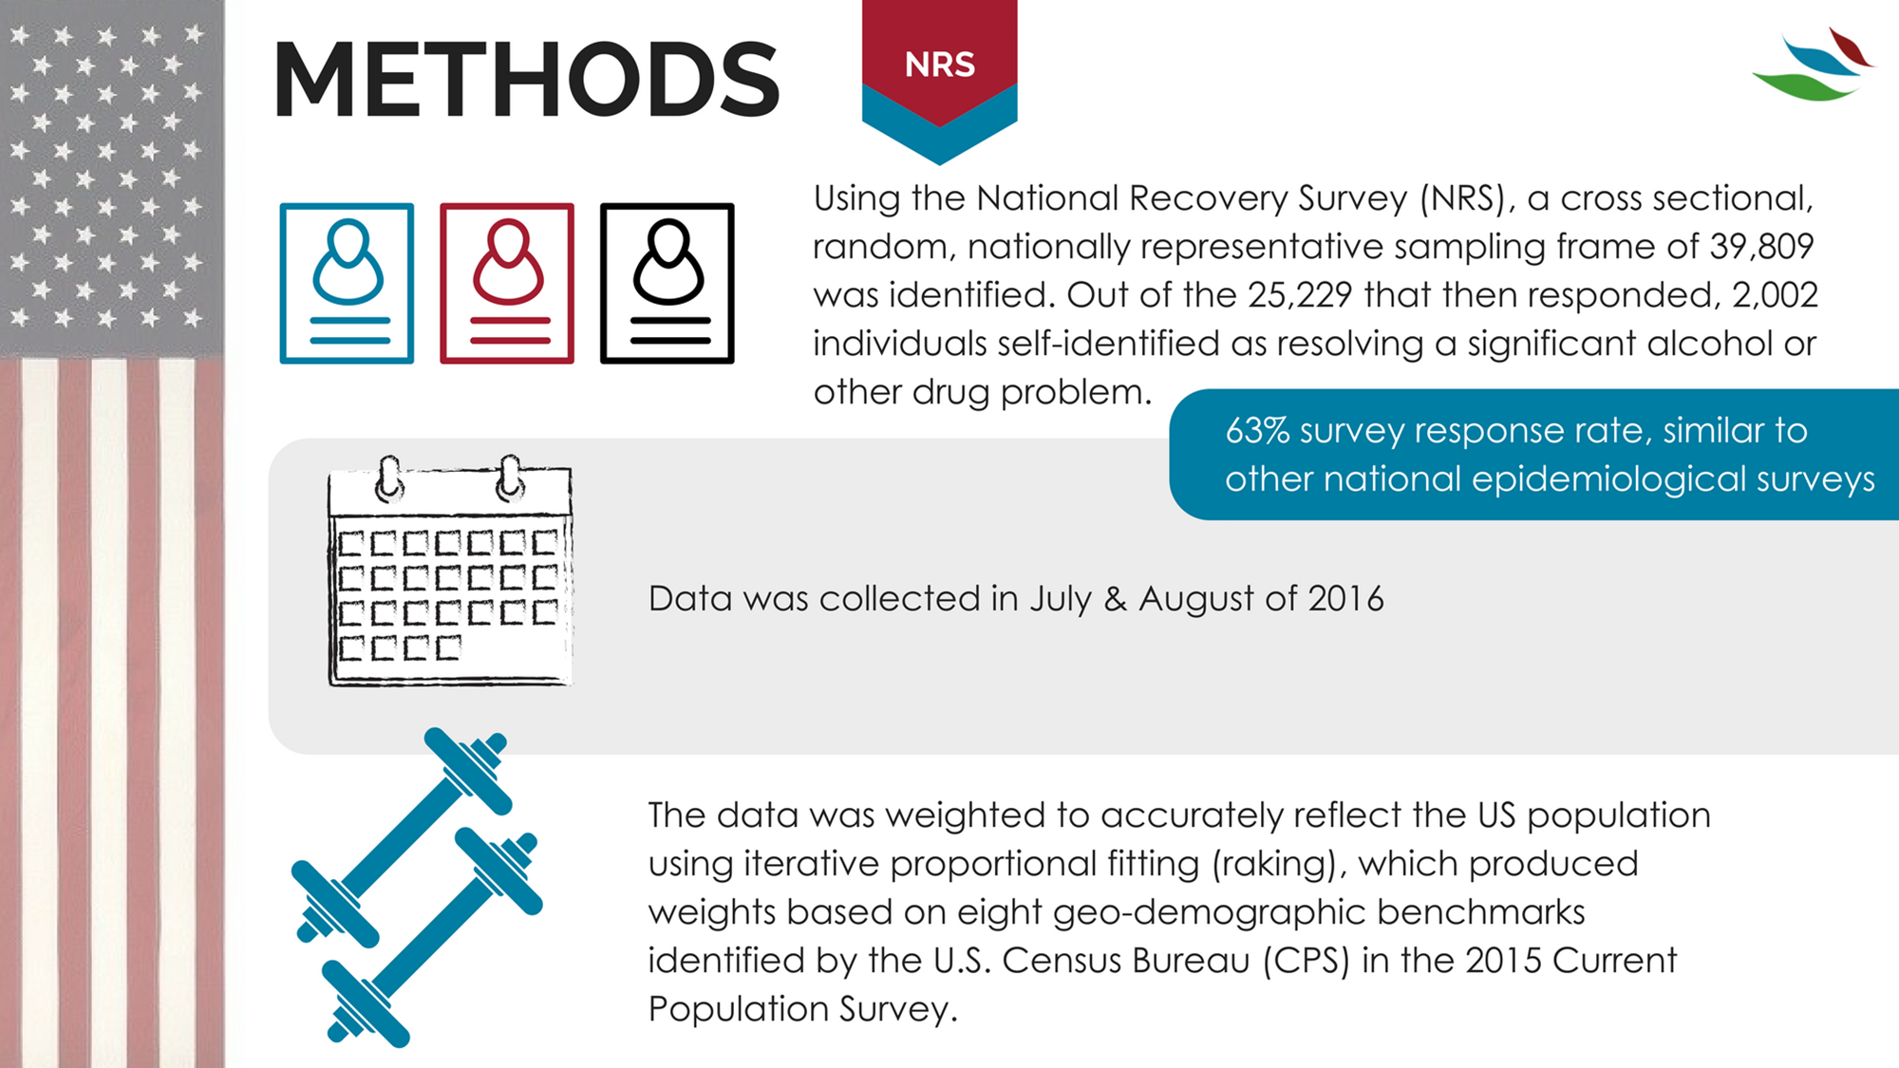

Slide 29
Sample Weighting
Weights were computed via comparisons to benchmarks from the March 2015 Current Population Survey (CPS; United States Census Bureau, 2015) along eight dimensions..
(1) gender (male/female)
(2) age (18–29, 30–44, 45–59, and 60+ years)
(3) race/Hispanic ethnicity (White/Non-Hispanic, Black/Non-Hispanic, Other/Non-Hispanic, 2+ Races/Non-Hispanic, Hispanic)
(4) education (Less than High School, High School, Some College, Bachelor and beyond)
(5) census geographical region (Northeast, Midwest, South, West)
(6) household income (under $10k, $10K to <$25k, $25K to <$50k, $50K to <$75k, $75+)
(7) home ownership status (Own, Rent/Other); and (8) metropolitan area (yes/no).

Slide 30
Response rate similar to other national epidemiological surveys
This response rate is comparable to most other current nationally representative surveys
NESARC-III; 60.1% (Grant et al., 2015)
2015 National Survey on Drug Use and Health (NSDUH; 58.3%; Center for Behavioral Health Statistics and Quality, 2016)
2013-2014 National Health and Nutrition Examination Survey (NHANES; 68.5%; Centers for Disease Control and Prevention [CDC], 2013).
Data were weighted to accurately represent the civilian population using the method of iterative proportional fitting, which is commonly referred to as “raking” (Battaglia, Hoaglin, & Frankel, 2013).

Slide 31
MEASURES
Demographic characteristics
Substance Use History
Medical History
Criminal Justice History
Treatment and Other Recovery Support Services
Problem Resolution/Recovery History
Recovery Capital
Psychological Distress
Quality of Life
Happiness
Self-Esteem

Slide 32
Recovery Research
National Recovery Study
What is the prevalence of alcohol or other drug problem resolution?
What proportion self-identify as being “in recovery”?
What are the pathways followed?
How many serious attempts does it take to resolve AOD problems?
What is quality of life and functioning like in recovery?

Slide 33
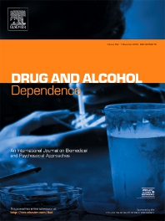

Slide 34
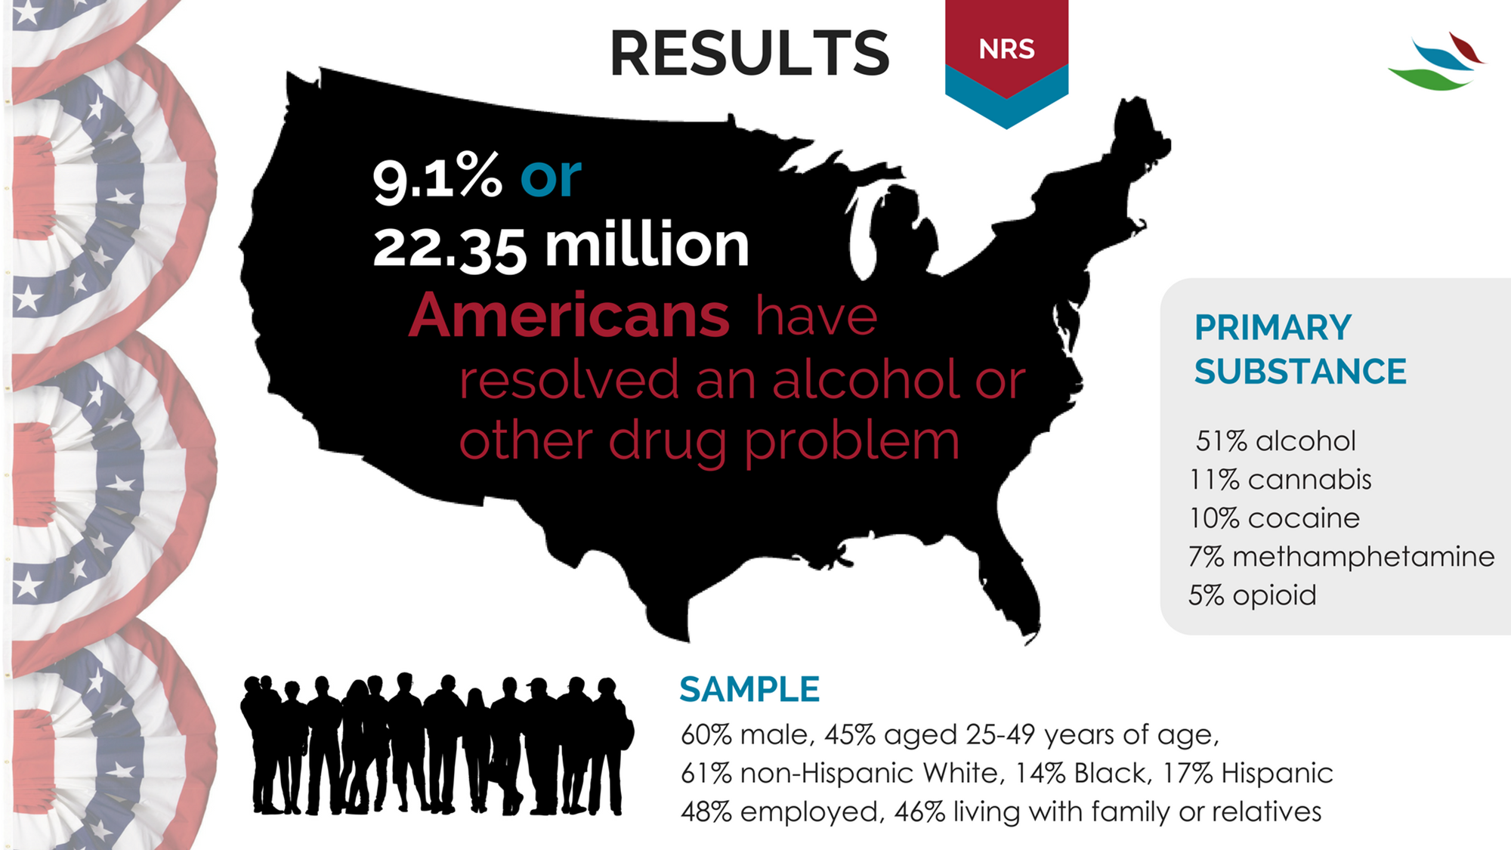

Slide 36
Recovery Research
National Recovery Study
What is the prevalence of alcohol or other drug problem resolution?
What proportion self-identify as being “in recovery”?
What are the pathways followed?
How many serious attempts does it take to resolve AOD problems?
What is quality of life and functioning like in recovery?

Slide 37


Slide 38

Proportion self-identify as being “in recovery”
46%
Odds of self-identifying in this manner associated with greater indices of greater severity (earlier age of onset, psychiatric comorbidities, greater treatment and recovery support services use)

Slide 39
Recovery Research
National Recovery Study
What is the prevalence of alcohol or other drug problem resolution?
What proportion self-identify as being “in recovery”?
What are the pathways followed?
How many serious attempts does it take to resolve AOD problems?
What is quality of life and functioning like in recovery?

Slide 40




MULTIPLE PATHWAYS TO RECOVERY
Acknowledges myriad ways in which individuals can recover:
Clinical pathways (provided by a clinician or other medical professional – both medication and psychosocial interventions)
Non-clinical pathways (services not involving clinicians like AA)
Self-management pathways (recovery change processes that involve no formal services, sometimes referred to as “natural recovery”).

Slide 42
Notes:
Alcoholics Anonymous (AA) 34.6 1.49 Narcotics Anonymous (NA) 17.5 1.23 Cocaine Anonymous (CA) 2.3 0.43 Celebrate Recovery 2.2 0.44 SMART Recovery 1.3 0.35 Women for Sobriety 1.2 0.37 Crystal Methamphetamine Anonymous (CMA) 0.8 0.37 Marijuana Anonymous (MA) 0.9 0.43 LifeRing Secular Recovery 0.4 0.27 Moderation Management 0.2 0.10 Secular Organizations for Sobriety (S.O.S.) 0.2 0.10 Other 3.2 0.47
Recovery support services 21.8 1.40 Faith-based recovery services 9.2 0.94 Sober living environment 8.5 0.95 Recovery community centers 6.2 0.85 State or local recovery community organization 3.0 0.61 College recovery programs/communities 1.7 0.52 Recovery high schools 0.8 0.37

Slide 43
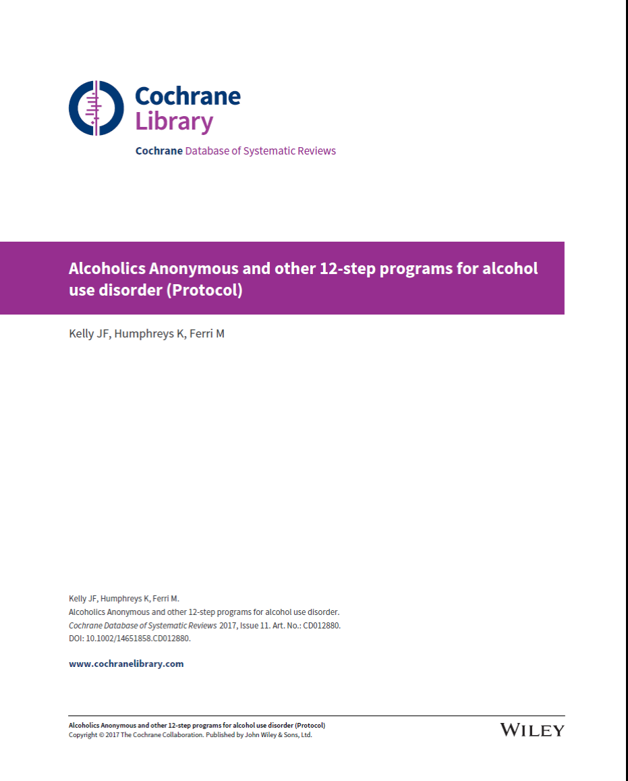

Slide 44
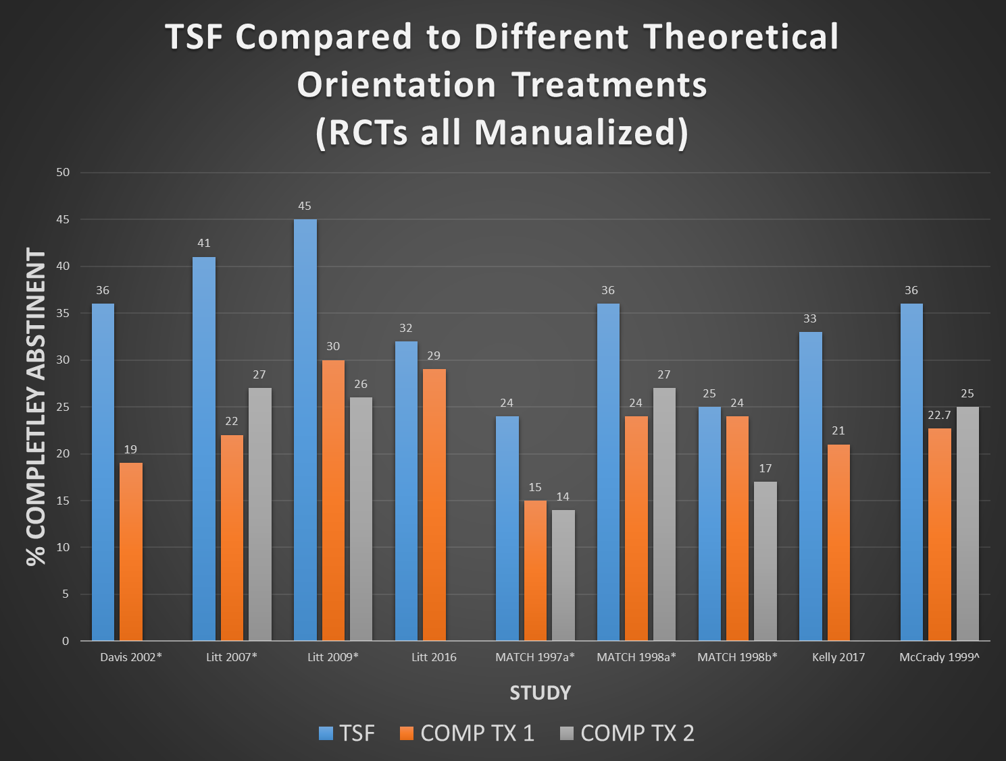

Slide 45
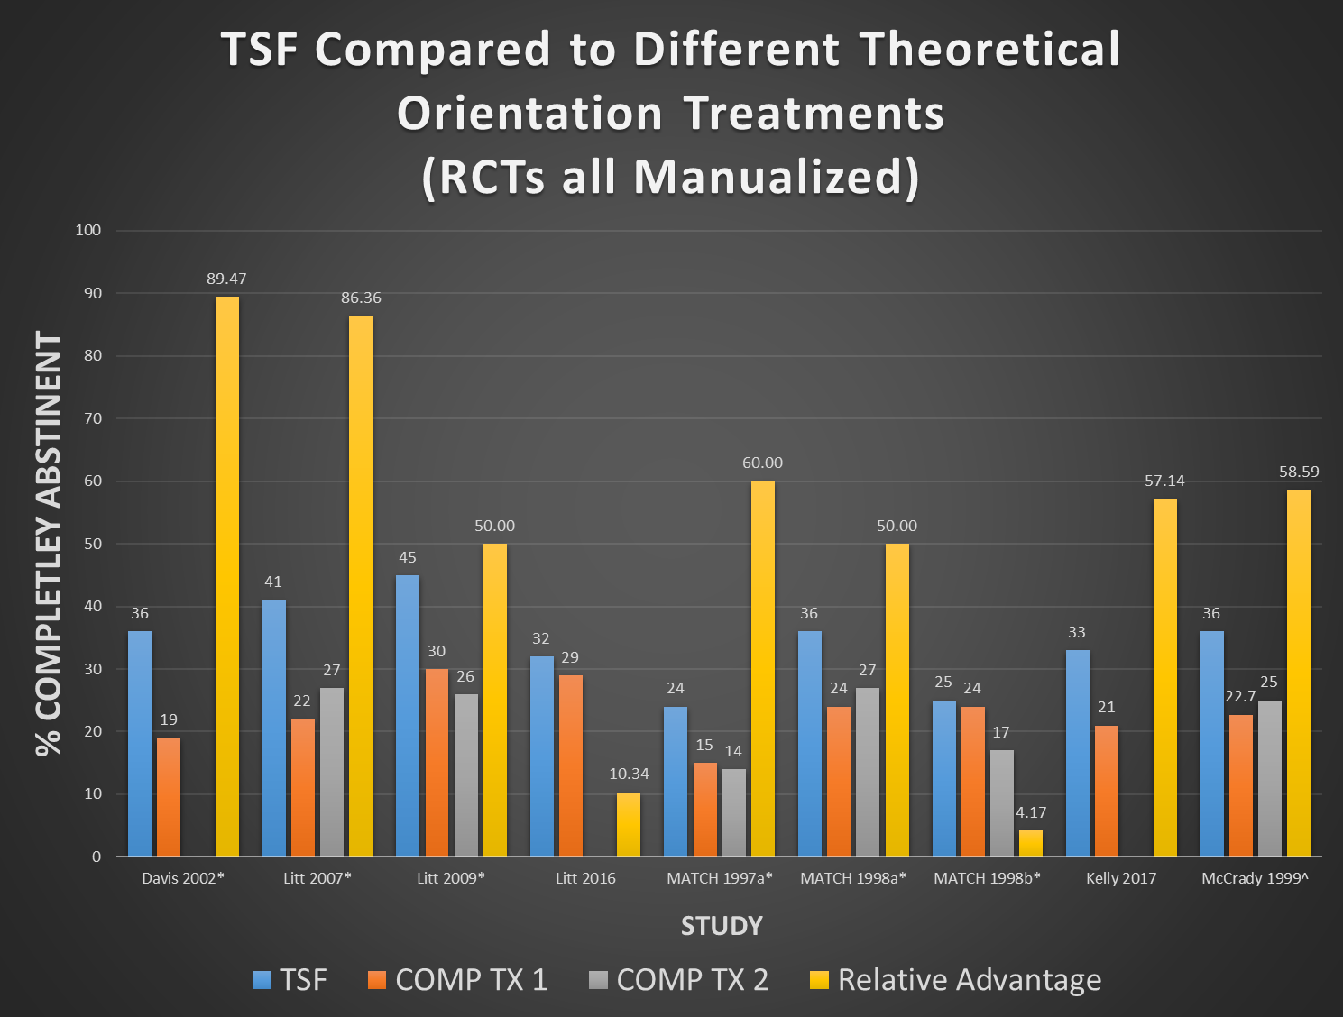

Slide 46
Health Care cost offset
CBT VS 12-STEP RESIDENTIAL TREATMENT
Compared to CBT-treated patients, 12-step treated patients more likely to be abstinent, at a $8,000 lower cost per pt over 2 yrs (potential $15 billion total savings for AUD patients nationally)
Also, higher remission rates, means decreased disease and deaths, increased quality of life for sufferers and their families

Slide 47
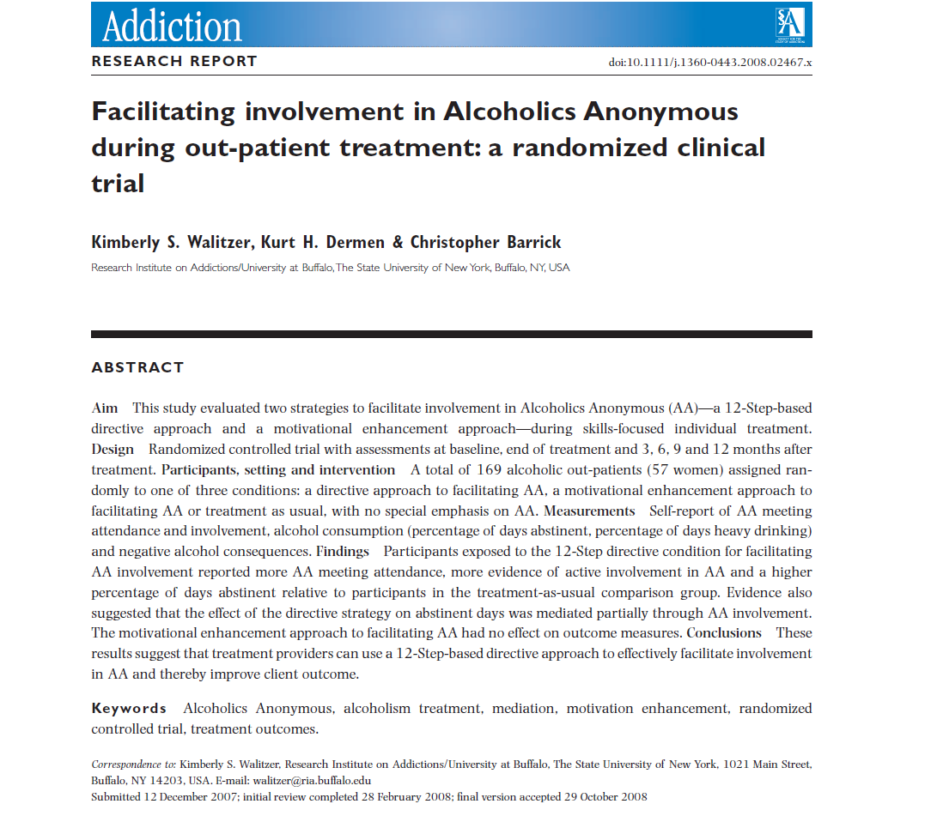
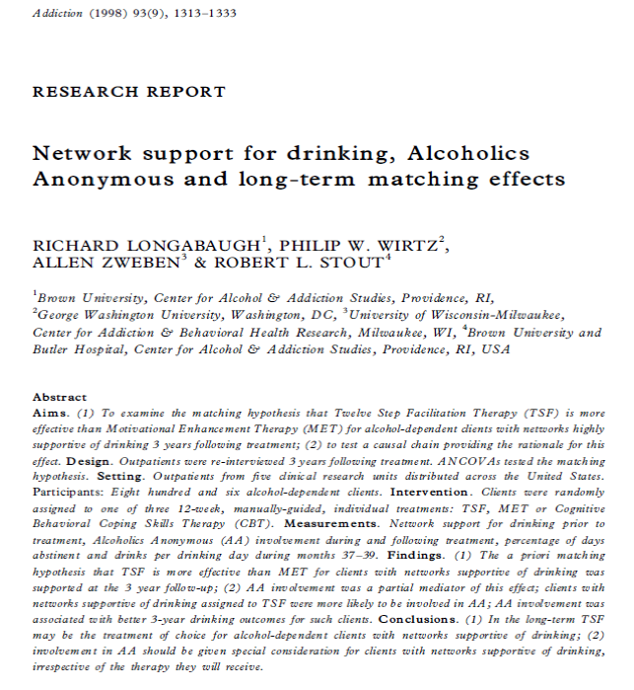
TSF often produces significantly better outcomes relative to active comparison conditions (e.g., CBT)
Although TSF is not “AA”, it’s beneficial effect is explained by AA involvement post-treatment.

Slide 48
TSF-AA-OUTCOME Causal chain supported…
BETTER OUTCOME
TSF
AA

Slide 49
What about support for causal chain of purported mobc of AA on outcomes?
MOBC?
BETTER OUTCOME
TSF
AA

Slide 50
Empirically-supported MOBCs through which AA confers benefit
Social network
Spirituality
Social Abstinence self-efficacy
Coping skills
Recovery motivation
Negative Affect Abstinence self-efficacy
Impulsivity
Craving
Notes:
So, if we apply these to models of common precursors to relapse…

Slide 51
Recovery Research
National Recovery Study
What is the prevalence of alcohol or other drug problem resolution?
What proportion self-identify as being “in recovery”?
What are the pathways followed?
How many serious attempts does it take to resolve AOD problems?
What is quality of life and functioning like in recovery?

Slide 52
Frequency Distribution of Serious Recovery Attempts Prior to Successful Resolution
(LEFT: Full sample RIGHT PANEL: Outliers removed)

Slide 53
Frequency Distribution of Serious Recovery Attempts Prior to Successful Resolution
(LEFT: Full sample RIGHT PANEL: Outliers removed)
Skewness=5.89, SE=0.57; Kurtosis=50.27, SE=9.66

Slide 54
Frequency Distribution of Serious Recovery Attempts Prior to Successful Resolution
(LEFT: Full sample RIGHT PANEL: Outliers removed)
 | Mean | Median
Full Sample | 5.35 (13.41) | 2 (1, 4)

Slide 55
Median Recovery Attempts by Primary Drug
Notes:
Primary substance
Alcohol
5.38 (13.45)
2 (1, 4)
Cannabis
4.62 (8.41)
2 (1, 4)
0, 100
0.29
0.771
Opioids
8.48 (21.08)
3 (1, 6)
0, 100
0.90
0.368
Stimulants
4.64 (8.03)
2 (1, 5)
0, 100
0.35
0.725
Other Drugs
3.00 (4.01)
1 (1, 6)
0, 20
-0.86
0.392
Depressive Disorder

Slide 56
Number of Recovery Attempts by Clinical and Recovery Support Services Use

Slide 57
Recovery Research
National Recovery Study
What is the prevalence of alcohol or other drug problem resolution?
What proportion self-identify as being “in recovery”?
What are the pathways followed?
How many serious attempts does it take to resolve AOD problems?
What is quality of life and functioning like in recovery?

Slide 58
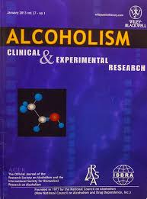

Slide 59
Inflection point at around 5 yrs

Slide 60
15yrs
Same QOL as gen. pop.
not achieved until
around 15yrs

Slide 61
Traditional addiction treatment approach: Burning building analogy
Putting out the fire -good job
Preventing it from re-igniting (RP) - less emphasis
Architectural planning (recovery plan) –neglected
Re-building materials (recovery capital) –neglected
Granting “rebuilding permits” - (removing barriers)
Notes:
15 yrs is too long to accrue QOL comparable to gen. pop. This may be due historically to acute treatment paradigm and lack of emphasis on “architectural planning” provision of “building materials” (recovery capital) and granting of “Building permits” . These may increase sense of personal agency and control over their lives and environment (and thereby possibly facilitate neurochemical changes that can decrease risk of relapse).

Slide 64


Slide 65
Comfort disclosing recovery status:
Compared to other primary substances, opioid group had the most difficult time disclosing …

Slide 67
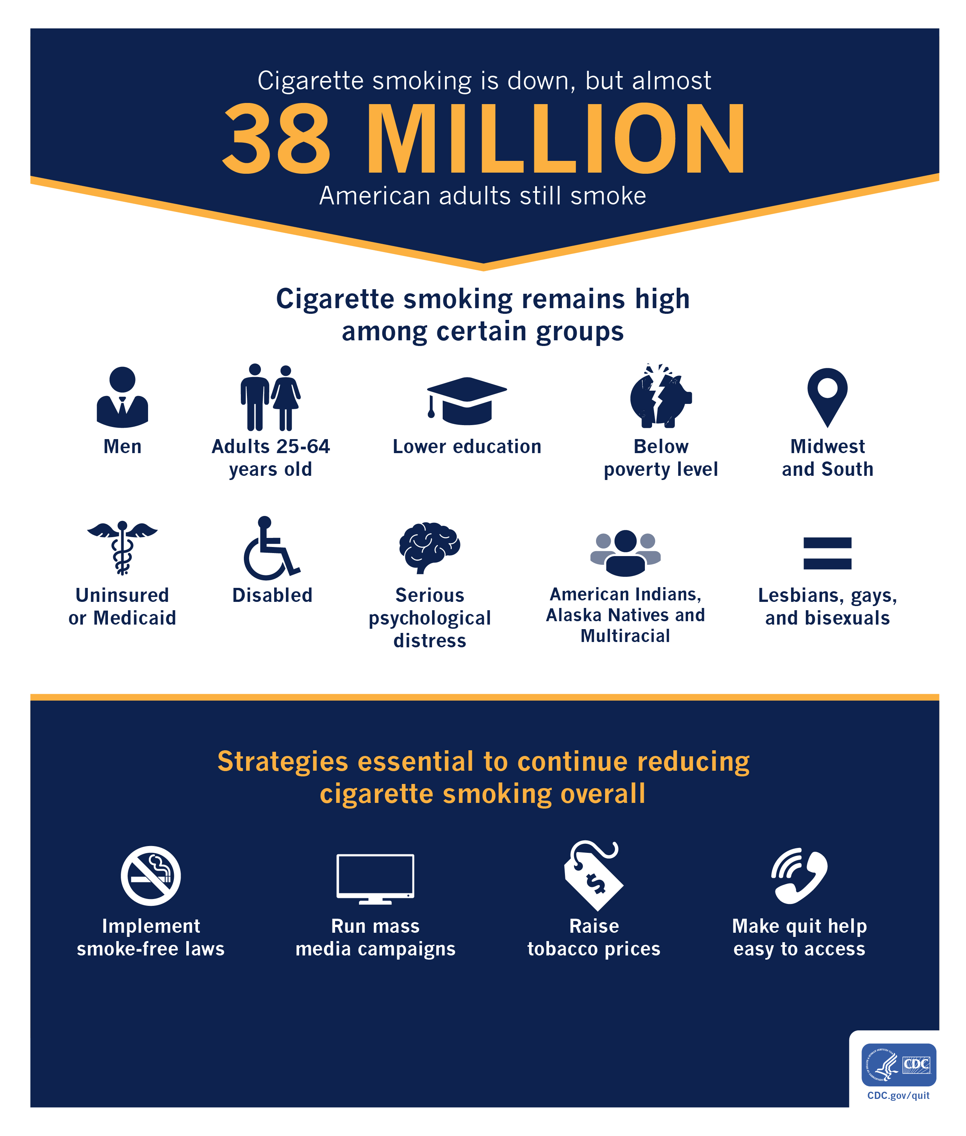
SMOKING CESSATION: National Recovery Study
Little is known about if and when people resolving AOD problems quit smoking, and if the salutary trends in smoking cessation observed in the gen. pop. are also observable among those recovering from AOD problems…
Kelly JF, Greene MC, Bergman BG, Hoeppner BB. Smoking cessation in the context of recovery from drug and alcohol problems: Prevalence, predictors, and cohort effects in a national U.S. sample
Notes:
REF:

Slide 68
SMOKING CESSATION: National Recovery Study
~70% of sample either current or former smokers
Findings consistent with other studies reporting high rates of tobacco use histories among individuals who use alcohol and other drugs
Kelly JF, Greene MC, Bergman BG, Hoeppner BB. Smoking cessation in the context of recovery from drug and alcohol problems: Prevalence, predictors, and cohort effects in a national U.S. sample
Notes:
REF:

Slide 69
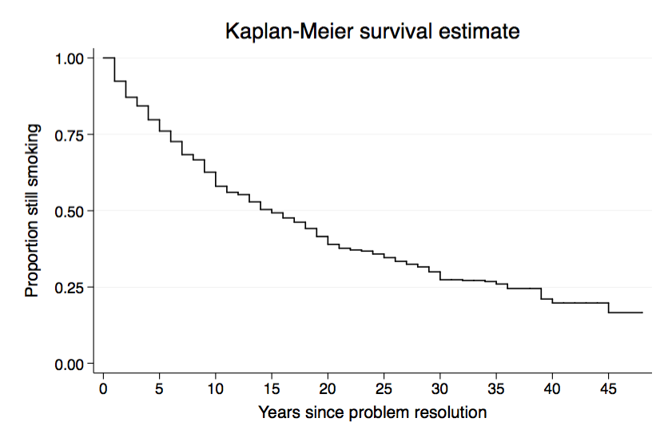
SMOKING CESSATION: National Recovery Study
Among those in recovery with smoking history, 30% quit smoking prior to entering recovery, 7% quit smoking at time of entering recovery, 26% quit after entering recovery; 27% still smoking.
Median number of years to smoking cessation among FS who quit after AOD problem resolution was 15
Kelly JF, Greene MC, Bergman BG, Hoeppner BB. Smoking cessation in the context of recovery from drug and alcohol problems: Prevalence, predictors, and cohort effects in a national U.S. sample
Notes:
REF:

Slide 70
SMOKING CESSATION: National Recovery Study
Table 3. Time to smoking cessation by problem resolution cohort (n=915)
AOD Resolution Cohort (%) | Cumulative incidence (5 years) | Cumulative incidence (10 years) | Survival Time (in years)
 |  |  | 25% | 50%
2006-2015 (53.95%) | 0.2717 | 0.5513 | 5 | 10
1996-2005 (28.70%) | 0.2406 | 0.3949 | 6 | -
1986-1995 (17.34%) | 0.1493 | 0.3447 | 8 | -
Total (100%) | 0.2334 | 0.4077 | 6 | 15
AOD problem resolved between 2006-2015: 27.17% and 55.13% quit smoking within 5 and 10 years after resolving AOD problem, respectively
AOD problem resolved between 1986-1995: 23.34% and 40.77% quit smoking within 5 and 10 years after resolving AOD problem, respectively
People who resolved their AOD problem more recently took less time to quit smoking relative to those who resolved their AOD problem less recently
Kelly JF, Greene MC, Bergman BG, Hoeppner BB. Smoking cessation in the context of recovery from drug and alcohol problems: Prevalence, predictors, and cohort effects in a national U.S. sample
Notes:
REF:

Slide 71
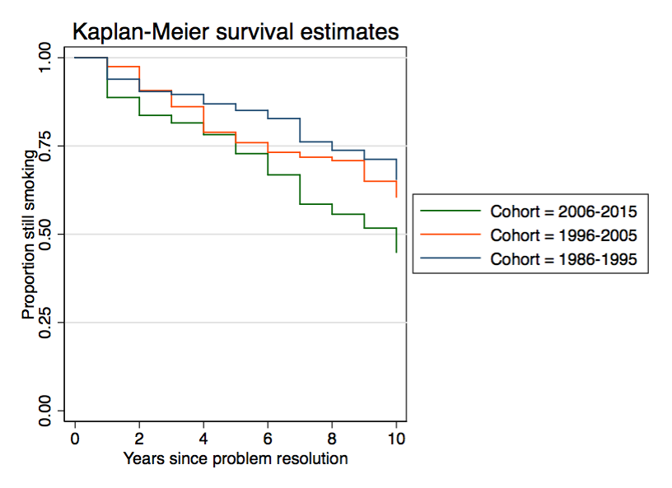
SMOKING CESSATION: National Recovery Study
See sharper (quicker) decline in smoking among those who resolved AOD problem between 2006-2015 relative to 1995-2005 and 1986-1995
Kelly JF, Greene MC, Bergman BG, Hoeppner BB. Smoking cessation in the context of recovery from drug and alcohol problems: Prevalence, predictors, and cohort effects in a national U.S. sample
Notes:
**There were no sig differences in time to smoking cessation between the 2006-2015 and 1996-2005 cohort**

Slide 72
Results Summary
9.1% or 22.35 Million Americans resolved sig. AOD prob.
Only about half self-identify as “in recovery” –those with less severe histories; similar crises but greater ability to stop sans help
Approximately half resolve these problems without any external assistance- related to less severity/complexity
Mean problem resolution attempts is around 5.5 but this number heavily skewed; Mdn number = 2; with high variability around estimates
QOL indices monotonic improvements over time, with steeper increases first 5 years, then ongoing, shallower, improvement; post “pink cloud” drop early; opioid/stimulant tougher time early on

Slide 73

Implications
RESEARCH AND POLITICAL ADVOCACY: Estimates here similar to prior national/regional, non probability-based estimates suggesting approximately 9.1% (20-25M) of adult Americans “in recovery”. Could learn more from this large, diverse, group; mobilize for change?
PUBLIC HEALTH & POLICY COMMUNICTION: Although term “recovery” used in past estimates, only about half identify as “in recovery”. Label adoption may serve adaptive funx; qualitative analyses suggest many resolving AOD may not relate and/or oppose this term; thus to engage more people public health and policy communication efforts might include “problem resolution” in addition to “recovery”.
HOW TO REACH MANY NOT SEEKING SERVICES, LESSEN IMPACT: In keeping with other studies, half resolved problem without help – those with lower severity and higher recovery capital. This large group still cause harm; how to reach/lessen impact.
RECOVERY NEEDS DYNAMIC, VARY BY SUBGROUP: QOL changes suggest “pink cloud” phase end may create early challenge; 1-yr things looking rosier; continue to improve; marginalized opioid/meth groups need recovery capital/support early on
REASONS FOR OPTIMISM: Prior estimates of quit/recovery attempts, may be “mean” averages, thus biased upwards (with skew); while reflective of high variability, medians should be used. These were low in non-clinical (Mdn=1) and higher in clinical (Mdn=3) samples (overall = 2 serious attempts prior to resolution; Mean=5.6; SD=13.41). Hopeful.

Slide 74





Thank you to our funders and supporters!!
The NIH and SAMHSA, MA Department of Public Health, and many others, especially the many philanthropic donors who continue to support our work at the Recovery Research Institute without whom this would never have started or be able to continue!
The many philanthropic donors
who have supported our efforts!!!

Slide 75




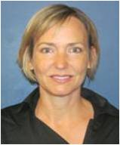


MGH Center for Addiction Medicine Faculty
CAM Staff
Kristina Schnitzer, M.D.
Kevin Potter, Ph.D.
Chien-Lin Caroline Yeh, Ph.D.
Sarah Hickey, BSN, BS
Francis Foley, BA
Kelsey Lowman, BA
Rachel Plummer, BA
Alyson Dechert, BA
Nate Phillips, BA, BS
William Schmitt, AB
Rachel Marcus, BA
Olivia Downer, BS
Audrey Steely, BS
Jessica Richman, BS
Sophia Allen, BA
Grace Wheeler, BS
Natali Rychik, BS
Erin Lamberth, BA
Eden Evins,
M.D., MPH
Gladys Pachas,
M.D.
Cori Cather,
Ph.D.
Randi Schuster,
Ph.D.
Melissa Maravic,
Ph.D., MPH
Jodi Gilman,
Ph.D.

Slide 76
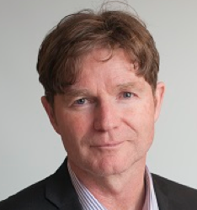






Recovery Research Institute Faculty
John F. Kelly,
Ph.D., ABPP
Brandon Bergman,
Ph.D.
Bettina Hoeppner,
Ph.D.
Corrie Vilsaint,
Ph.D.
David Eddie,
Ph.D.
Lauren Hoffman,
Ph.D.

Slide 77







Recovery Research Institute Staff
Christopher Rattan,
MPH
Alexandra Abry,
BA
Hannah Carlon,
BA
Amanda Haik,
BA
Claire Kane,
BA
Sarah Dickerman,
BA
Akshiti Todi,
BA

